Slide 1


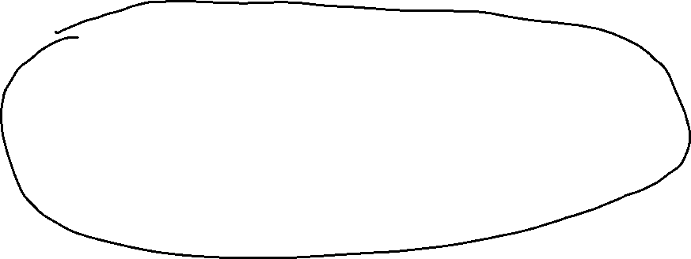
ICT4D Information and Communication Technologies for Development

Slide 2
ICT4D
ICT4D is an initiative aimed at bridging the digital divide and aiding economic development by ensuring equitable access to up-to-date communications technologies
The United Nations, through its UN Development Programme, actively promotes ICT4D as a powerful tool for economic and social development around the world.
ICT4D is a global equity program. Many NGOs use ICT4D to help facilitate sustainable growth in impoverished and marginalized communities.
ICT4D is an inter-disciplinary theme which include development economics, Technology, globalization, geography, marginalization, global equity, etc.
ICT is considered as important tool to achieve UN SDGs
Critics of ICT4D call it another western tool to further the capitalist interest of the developed North at the expense of the global south

Slide 3
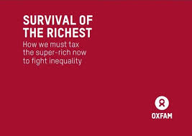
Survival of the Richest
the richest 1% in India now own more than 40% of the country’s total wealth, while the bottom half of the population together share just 3% of wealth between 2012 and 2021.
taxing India's ten-richest individuals at 5% could generate enough money to bring children back to school
India’s Tax revenue( last few years Avg)
Corporate Tax: 6-7 lakh crores
Income tax: 5-6 lakh crore
GST: 15-16 lakh crore
country's marginalized communities such as Dalits, Adivasis, Muslims, Women, and informal sector workers are continuing to suffer in a system that prioritizes the survival of the richest.
The poor in India are paying disproportionately higher taxes, and spending more on essential items and services when compared to the rich.
Nearly 64% of the total Rs 14.83 lakh crore in GST(2021-22) was paid by bottom 50% of the population( poor people !)
female workers earned only 63 paise for every 1 rupee a male worker earned.

Slide 4
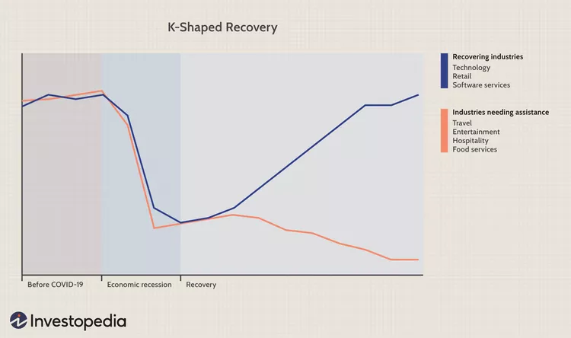
Post COVID-19 pandemic, concerns are being raised about deepening inequalities in India, with some calling it as a 'K-shaped' recovery, where rich emerged richer while the poor slipped down further

Slide 5
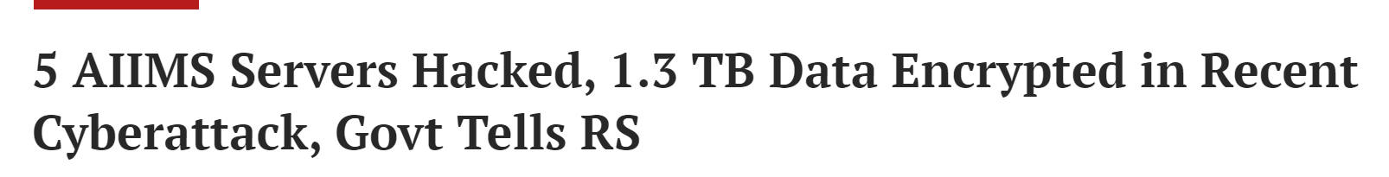
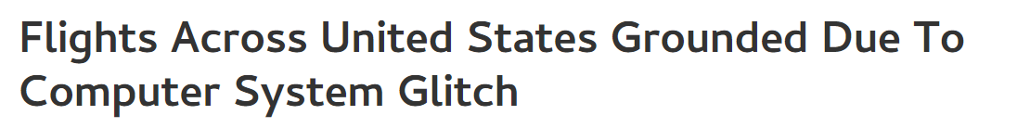
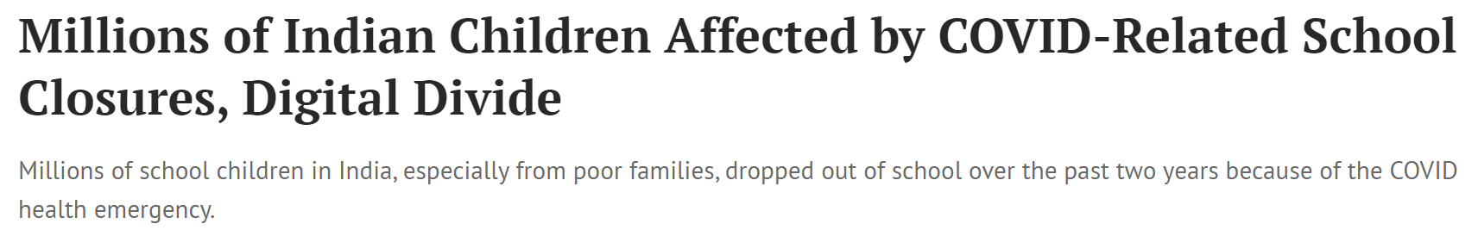
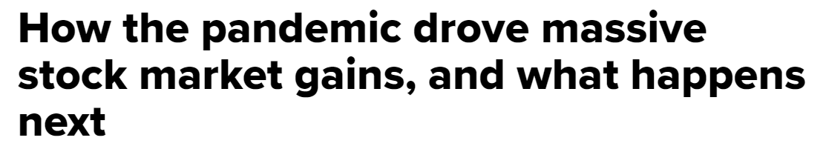
PERILS OF TECHNOLOGY DEPENDENT DEVELOPMENT

Slide 6







Course Objectives
To debate the notion of development as a sociological concept, with a particular focus on developing countries, such as India. Discuss the development as Discourse and alternate models of development. Discuss development as a multi-faceted phenomenon and Discuss its socio-economic impacts
b) Discuss the role of technology, especially Information and Communication Technology, in development.
c) To formulate the idea of social media, as a component of ICTs, and the role they play in shaping the contours of development in the digital society.

Slide 7
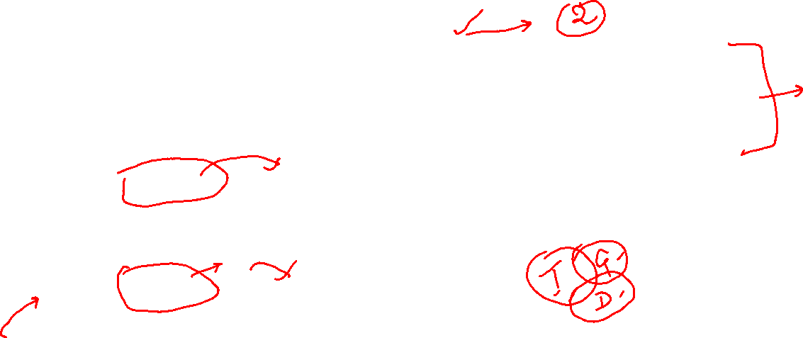
Syllabus
Unit – 1 : Introduction to the idea of Development
This unit will introduce the conception of development to Engineering students from social science perspective. Studying development as an essentially contested concept. Understanding the various meanings & connotations of development. Development as a discourse. Development and modernisation theories and challenges to them. Human development and its dimensions. Alternative models and conceptions of development.
Unit – 2 : Globalization and Development
This unit will specifically look at globalization as a socio-economic disruptor having far-fetched implications for not only economic development for a country but also bringing cultural transformations. Dimensions and alternative perspectives of globalization.
Unit – 3 : Technology and Development
This unit will introduce the meaning, dimensions, and role of technology in development. Historical overview of technological development. ICT, its components, and evolution. Role of ICT in development, especially in education, healthcare, livelihoods, entertainment, and governance.

Slide 8
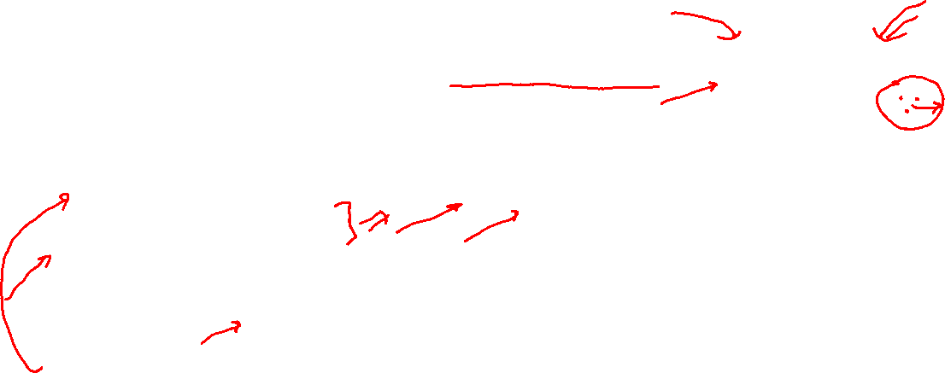
Unit – 4 : Introducing Information and communication technologies as harbingers of social change
Under this topic we will debate and discuss the nature and contours of new channels of information, social networking, the rise of social media and online content generation. Questions posed by these digital artefacts evaluate the inherently democratizing, process of owning, using and networking with new media technologies.
Unit – 5 Case Studies on ICT
With the help of case studies, with a focus on India, we will articulate the implications of new and digital media in everyday life. Focus on the sociology of new media technologies, with a specific aim to anchor them within select theoretical debates and in specific geographic contexts.
Unit – 6 Digital Media( Social Media) as a Developmental tool
Research had pointed to the rich field of utilization of new media tools for leisure and social networking as well as the unique affordances they spawn in the arena of self-expression and acquiring socio-digital identities. For example, the pre-pay mobile internet made web surfing an affordable and engaging activity even in the down markets and resource poor social ecologies of urban India. As social media penetrates further, a greater number of voices will be able to be heard on a global scale. This change can be embraced and utilized by development practitioners to empower and communicate with communities. The topic will include case-studies on social segments in resource-poor and emerging market settings [for example, ‘Twitter in Political campaigns, Facebook use in the urban slum].

Slide 9
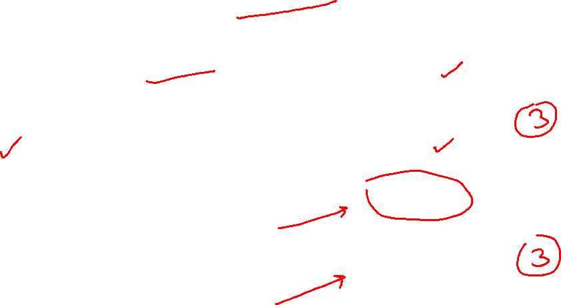
Assessment Plan- Tentative
Class Quizzes( Both Planned & Surprise)- 20 Marks
Mid Sem 20 Marks
Project 30 Marks
End Sem 30 Marks

Slide 10
Meaning of Development
ICT4D
WEEK 1
From Social Science Perspective

Slide 11
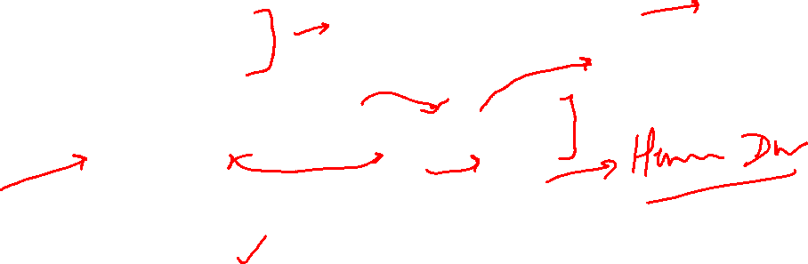
What are intended to be covered?
What meaning and connotations are conveyed by the word ‘development’
Are these meanings fixed?
Is development a discourse? A social construct?
Alternative meanings and models of development

Slide 12
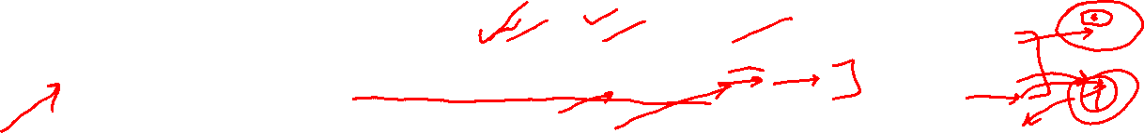
Think of these conditions…Do they denote development?
A small fruit plant, with time, grown into a big tree but doesn’t bear any fruit.
A small child became big strong men and joined gang of Robbers
A poor community, yet living harmoniously, found gold mines, became rich & resourceful, but excess money bred competition, jealousy, possessive individualism, and disharmony
A big Dam over a river gave water, electricity, jobs making many people well off, but displaced thousands of poor tribals
India when colonized got Railways, Telegraph, Ports, Modern Industries, modern education and medical system, and social reforms
A nation exhausted all its vital resources to grow its GDP manyfold in short time

Slide 13
Meaning of the word ‘Development’
Dictionary meaning
an event constituting a new stage in a changing situation.
the process in which someone or something grows or changes and becomes more advanced (Cambridge dictionary)
Change from an existing to desired state
Synonyms
Evolution, growth, progress, maturing, advancement, moving forward, expansion, spread, blossoming, flourishment

Slide 14
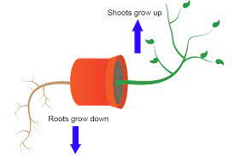
Growth vs Development
Growth:
the process of increasing in size.
An increase, as in size, number, value, or strength; extension or expansion.
Growth is quantitative and value neutral. It may have a positive or a negative sign
Development denotes a qualitative change which is always value positive- Development is value judgemental concept
Development indicates a positive growth which is considered qualitatively good
Examples:
Growth: population increasing by 10 %; Development: population becoming more healthy, literate, and resourceful
Growth: child growing to adulthood with increased size, weight; Development: the grown up man becomes well groomed good human being

Slide 15
Development: what, for whom, and how?
Development for whom? Referent point?
Nation?
faster growth of national resources( GDP), formidable security, stable Government, more relative powers and capabilities, etc.
Civil Society/communities/people?
Civil liberties and rights, socio-economic welfare, material prosperity, harmony, social solidarity, etc.
Individual?
Adequate material resources, social well-being, civil liberties & rights, capabilities and choices, etc.
who has the power to do Development and to whom?
Developed vs. Underdeveloped
External vs self-Development
How?
Methods, mechanisms, and pathways of development

Slide 16
Development as Discourse

Slide 17
Development as ‘Discourse’
Discourse:
Special terminology and language used to create identities, define structures, and explain behaviour in a particular socio-cultural context or domain.
Social construction of reality, assigning meanings to idea/concept
How identity, structure, and behaviour are normalized and institutionalized
Examples: Modernity, Nationalism, 3rd World, Liberalisation, masculinity/femininity, Communal, ‘Cool’, ‘Chill’
Contemporary meaning of Development
Material prosperity by fast growth in resources( income/wealth), industrialisation, scientific & technological innovations, automation, etc.
Closely linked to idea of modernisation- modern political values & norms( democracy, Justice, Liberty, Equality, Rights), modern life style ( individualistic, materialistic, scientific, reasoned/rational)
How and by whom the contemporary discourse of Development was created?

Slide 18
Discourse of Development: Genealogy
In ancient period, philosophers considered human progress cyclical
Aristotle- virtuous conditions degenerate over time, then regenerate
Enlightenment period( 18th century Europe)- progress in human civilization linear, may be continuous with scientific evolution- liberal conception of development
Hegel: Continuous Progress in human civilization through development of ideas- thesis-antithesis- synthesis
Marx: development is continuous progression in mode of production through class struggle
1949: Truman's famous address gave contemporary discourse of development
Developed vs underdeveloped
Development as faster production, and material well-being by scientific, technocratic methods by experts and by employing capital
Development is Modernization
Universal concept, mechanisms across all socio-cultural contexts

Slide 19
Why Poverty and Underdevelopment? Why Poor Countries poor?
Internal Vs External Reasons
Internal: Factors that are within the individual/community/nation
Worldview, belief, and ideas of the individual, culture of nation
External: Factors that are outside
External factors for individuals: background inequality, social bad luck, disempowerment, marginalization, unfreedom
External factors for nation : Dominance, subjugation, colonization, unfreedom, exploitation
Modernization theory, led by Western Thinkers, focused on internal factors
Dependency Theory, led by neo-Marxist and post-colonial thinkers, focused on external factors

Slide 20
Political Dimension: Development and Modernisation theory
During 1950s-70s, the Western World led by USA created the discourse of Development and modernization
'Developmentalism’ - conceptual paradigm
there is a fixed path of development & modernization as traversed by western nations; by following the same path, poor 3rd world nations would also become developed.
Development:
Rapid industrialization, free trade, leverage market, fast GDP growth, economic prosperity, material comforts, etc.
Modernization:
Liberal Democracy, modern institutions, modern education, health, transport, communication system; modern political values- Liberty, Rights, Equality, pluralism, secularism, reason/rationality, scientific temper, individual autonomy, etc.
In western discourse development is universal, objective, scientific, technocratic, progressive, and politically neutral

Slide 21
Challenges to Developmentalism : Dependency Theory
Dependency theory criticized the dominant model of development as ‘Eurocentric’, furthering the capitalist interests of the ‘West’.
Core vs Periphery
Global economic system- core- developed nations of ‘West’; periphery: poor nations of 3rd world
Metropolitan vs satellite
Developed region of poor 3rd world nations act as satellite of Metropolitan centers in West
Metro- satellite pattern in underdeveloped nation
‘Development of Underdevelopment’
In this view ideology, interest, and politics permeate the discourse of development
Notes:
development of the West had come on the shoulders and at the cost of the non- West.

Slide 22
Human Development

Slide 23
Human Development-1/3
Development is all about enlarging people’s choices in order to lead long, healthy lives with dignity (Dr Mahbub-ul-Haq)
Development is increasing freedom through social and political institutions and processes (Prof Amartya Sen)
Freedom is capabilities to do desired things and achieve well-being
Human Development:
Resources & capabilities to make choices to have meaningful life
Process of improving human life, making it more meaningful- human flourishment
By (as given by Economist Michael Todaro)
1. increase standard of living ;
2. Increasing range of choices- increase freedom;
3. Create conditions conducive to ensure self-esteem and dignity of individuals

Slide 24
Human Development-2/3
3 dimensions: access to resources, health and education
4 Pillars: equity, sustainability, productivity and empowerment
4 Approach: Income approach; Welfare approach; Minimum needs approach; Capabilities approach

Slide 25
Human Development- Dimensions, Pillars, Approaches
3 dimensions: access to resources, health and education
Access to Resources/Standard of living: gross national income per capita- proxy indicator
Health: life expectancy at birth- proxy indicator
Education- mean of years of schooling for adults aged 25 years and more and expected years of schooling for children of school entering age
4 Pillars: equity, sustainability, productivity and empowerment
Equity: proportional equality- equal access to opportunities available to everybody.
Sustainability: continuity in the availability of opportunities, available to future generations
Productivity: human labour productivity or productivity in terms of human work
Empowerment: to have the power to make choices. Such power comes from increasing freedom and capability

Slide 26
Human Development- Approaches
4 Approach: Income approach; Welfare approach; Minimum needs approach; Capabilities approach
Income Approach: The idea is that the level of income reflects the level of freedom an individual enjoys
Welfare Approach: Individuals as recipients of Government Welfare Schemes
Minimum Needs Approach: Government to provide basic needs-health, education, food, water supply, sanitation, and housing- to all segments of society
Capability Approach: Building human capabilities in the areas of health, education and access to resources, by social empowerment, economic justice, and political freedom.

Slide 27
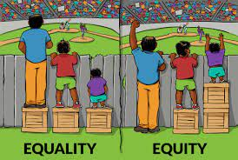

Slide 28
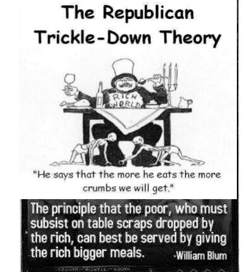

Slide 29
Human Development-3/3
Negative and Positive conceptions of human Development
Negative: modern, western, liberal conception
Equality of opportunity, Rights, Liberty, material resources, physical comforts/pleasure
Negative freedom, Negative Rights
Positive: ancient, normative, philosophical
Flourishment of human life, happiness, self-autonomy, self-realization, moral perfection
Positive freedom, positive rights
Human Development Index(HDI):
By UNDP, composite index between 0-1 to denote human Development in a country
Proxy indicators
Access to resources( living standard)- per capita GNP
Long and healthy life- life expectancy at birth
being knowledgeable- mean of years of schooling for adults aged 25 years and expected years of schooling for children of school entering age
Notes:
does not reflect on inequalities, poverty, human security, empowerment

Slide 30
Limitations of HDI:
Measures attainments Not shortfall in human development
Human poverty index: The probability of not surviving till the age of 40, the adult illiteracy rate, the number of people who do not have access to clean water, the number of small children who are underweight, etc.
Does not say anything about the distribution
Ex: per capita GNP grew by 10 % but median per capita income reduced by 10%, persons below poverty line increased by 10 %, how?
Does not reflect on inequalities, poverty, human security, empowerment, and positive development

Slide 31
Sustainable Development Goal- SDG
Developmental goals for the globe designed to be a "blueprint to achieve a better and more sustainable future for all“
Passed by UNGA resolution, in 2015, called Agenda 2030
The 17 SDGs are:
(1) No Poverty, (2) Zero Hunger, (3) Good Health and Well-being, (4) Quality Education, (5) Gender Equality, (6) Clean Water and Sanitation, (7) Affordable and Clean Energy, (8) Decent Work and Economic Growth, (9) Industry, Innovation and Infrastructure, (10) Reduced Inequality, (11) Sustainable Cities and Communities, (12) Responsible Consumption and Production, (13) Climate Action, (14) Life Below Water, (15) Life On Land, (16) Peace, Justice, and Strong Institutions, (17) Partnerships for the Goals.
SDGs pay attention to multiple cross-cutting issues, like gender equity, education, and culture
Elaborate mechanism to monitor progress on each goal

Slide 32
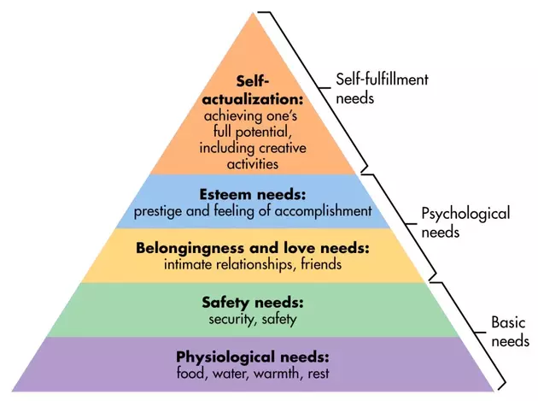
Psychological dimension : Maslow's hierarchy of needs
Theory of human developmental psychology
Once a lower level need is met, more or less, one start to feel higher level need
Human develops by rising on the need hierarchy
Flourished, fulfilled life is one which could meet the Self-actualization need

Slide 33
Alternate Conceptions of Development
Gandhian model
Marx’s model

Slide 34
Gandhian Notion of Development
Development is Freedom- Swaraj
For individual it denoted self-mastery, self-control, self-restrain, self-realization, moral goodness & perfectibility
For Community it meant self-governing autonomous community life without any formal coercive authority; full rights of civil liberties, and civil disobedience against any unjust actions/law of the state/govt
For political economy it denoted classless economic order, equal honour/dignity for all kinds of labour, self-renunciation( limiting our wants), Trusteeship
It also meant freedom from want, material possession, ego, bondage of so called modern materialistic life- modern large machine, faster transport system, competition/conflict-court/lawyer, modern medical system-doctors, etc.
In sum, it was his vision of an ideal civilisation based on Non-violence (अहिंसा), Truth, and moral duty (Dharma) in contrast to western modern civilisation based on violence/force, material possession, and Rights

Slide 35
Gandhian Oceanic Circles: Community of Communities
Central Govt
Provinces
Districts
Talukas
Village Community
Individual
“Life will not be a pyramid with the apex sustained by the bottom. But it will be oceanic circle whose centre will be the individual always ready to perish for the village, the latter ready to perish for the circle of villages, till at last the whole becomes one life composed of individuals, never aggressive in their arrogance, but ever humble, sharing the majesty of the oceanic circle of which they are integral units.”

Slide 36
Marxian concept of Development
Development is historical evolution in mode of production through class struggle
Primitive subsistence society--→master-slave society--→ Feudal Society( lord-serf)--→ Capitalist society( capitalist-labourer)--→ Socialist society ( Dictatorship of Proletariats') --→ Communist Society
Communist Society- Final stage of development
Classless, stateless society
Development is freedom
True freedom is social production in which each individual contribute freely as per his ability, and get as per one’s need and relate to fellow man as equal
Human development is Man working to realise essence of being human, act of self-realization
“it will be possible for me to do one thing today and another tomorrow, to hunt in the morning, fish in the afternoon, rear cattle in the evening, criticize after dinner, doing just that which gives me pleasure without ever becoming a hunter, fisherman, shepherd or critic. This will be the real state of freedom for man from alienation and exploitation”(Marx)

Slide 37
THANKS FOR LISTENING!
BE SAFE …GOOD WISHES !

